Slide 1

VOLKSWAGEN
Customer Service Portal

Slide 2
objective
To develop a automated customer service portal for Volkswagen company.
Automated letter generation from template
Minimal UI/UX

Slide 3

screenshots

Slide 4
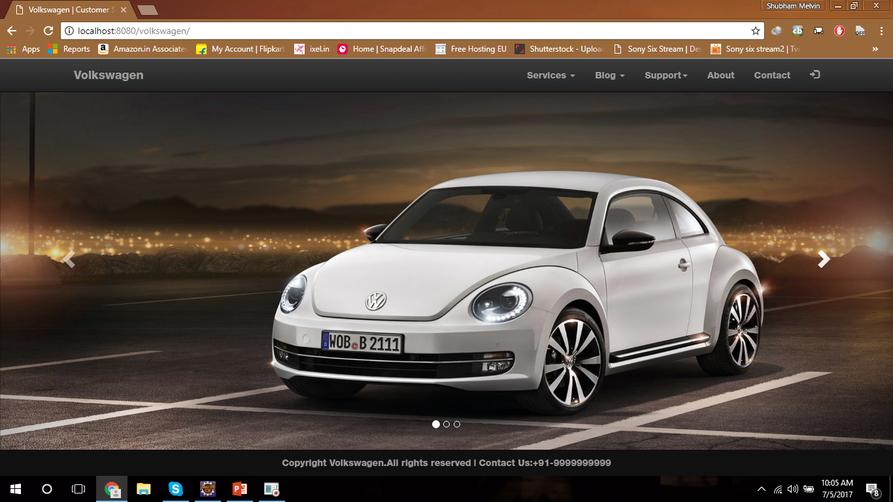
HomePage

Slide 5
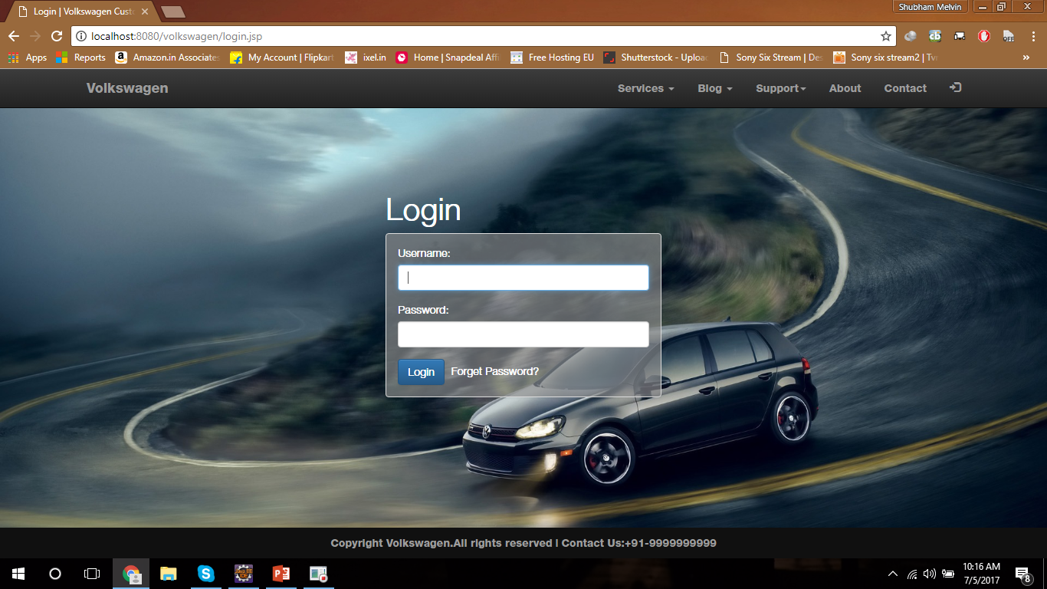
LOGIN

Slide 6
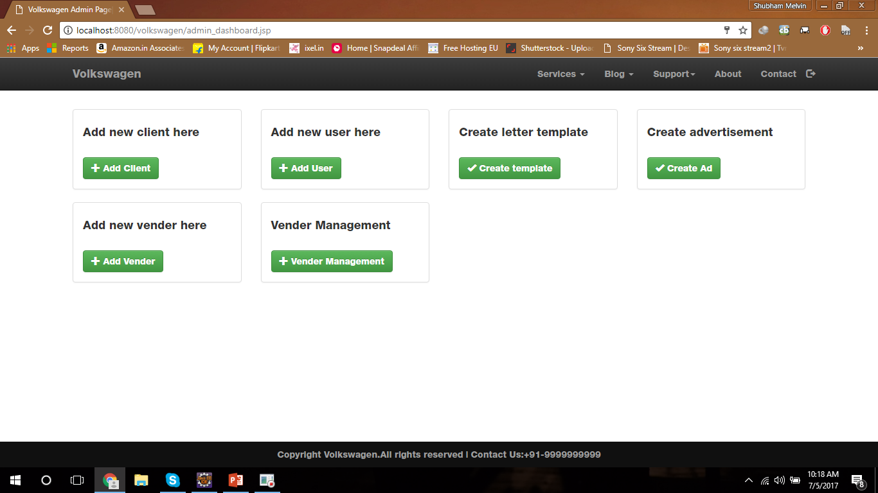
Admin dashboard

Slide 7
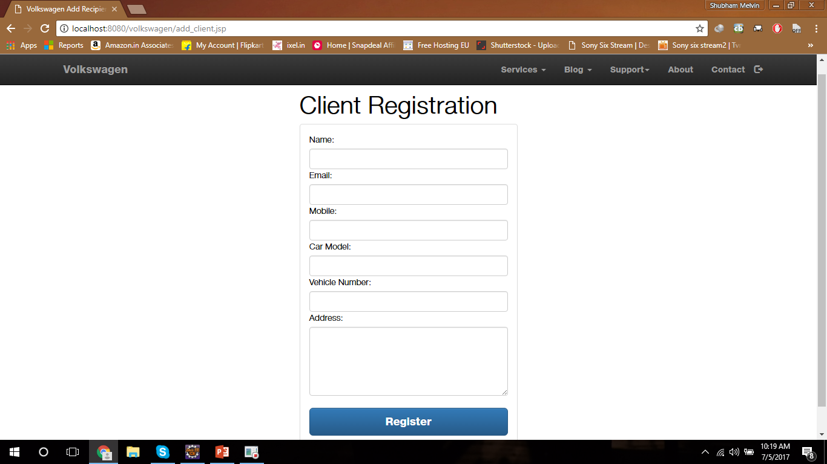
Client’s registration form

Slide 8
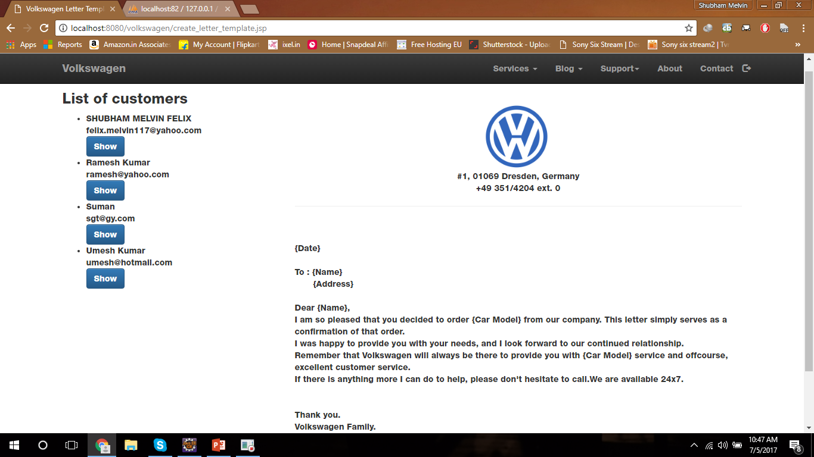
Letter template

Slide 9
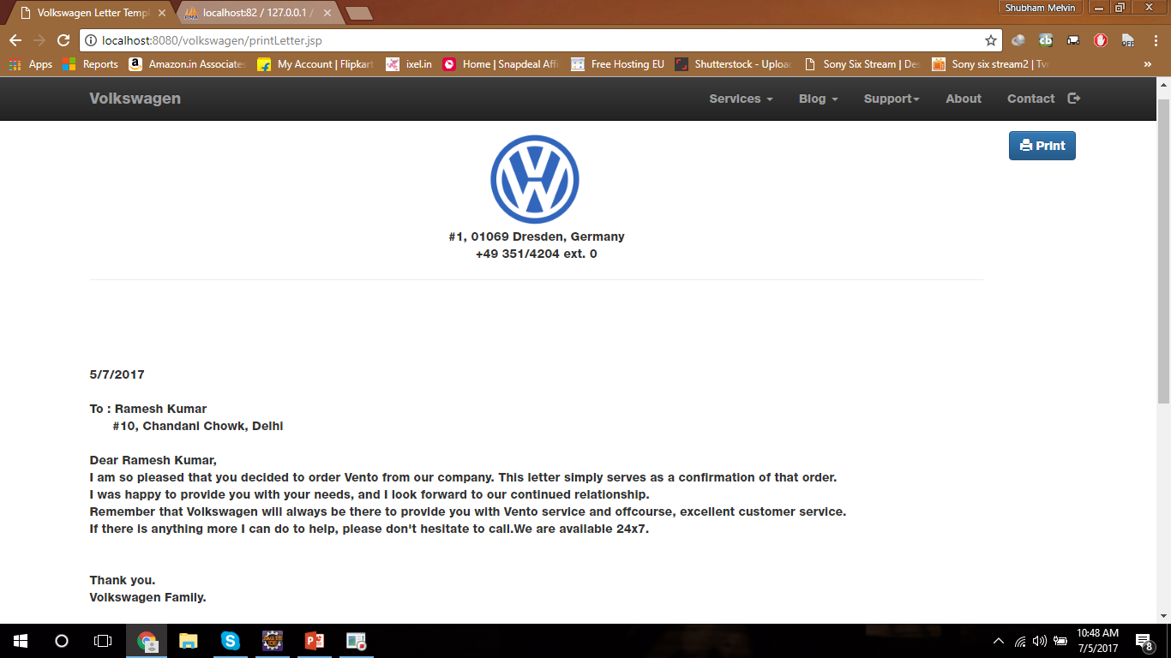
Letter printing

Slide 10
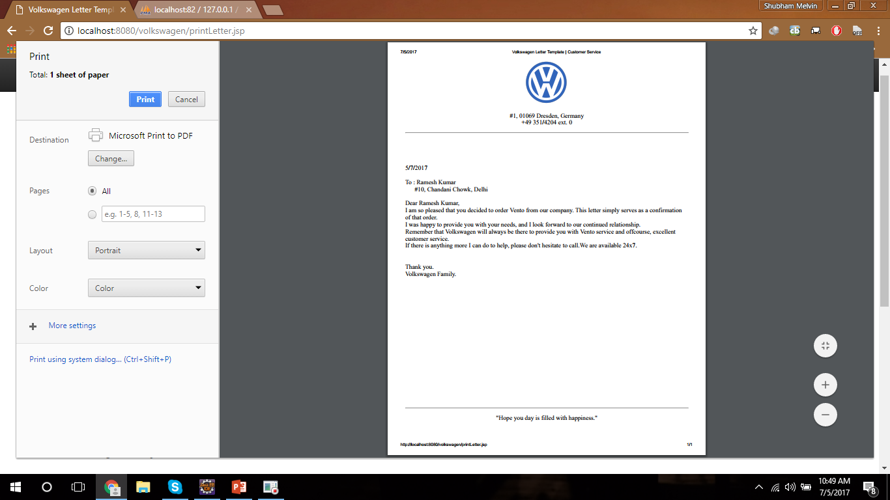
Print preview
Print Preview of Letter in A4 size paper
Save as pdf format
Print it
Save to local drive and mail it to user

Slide 11
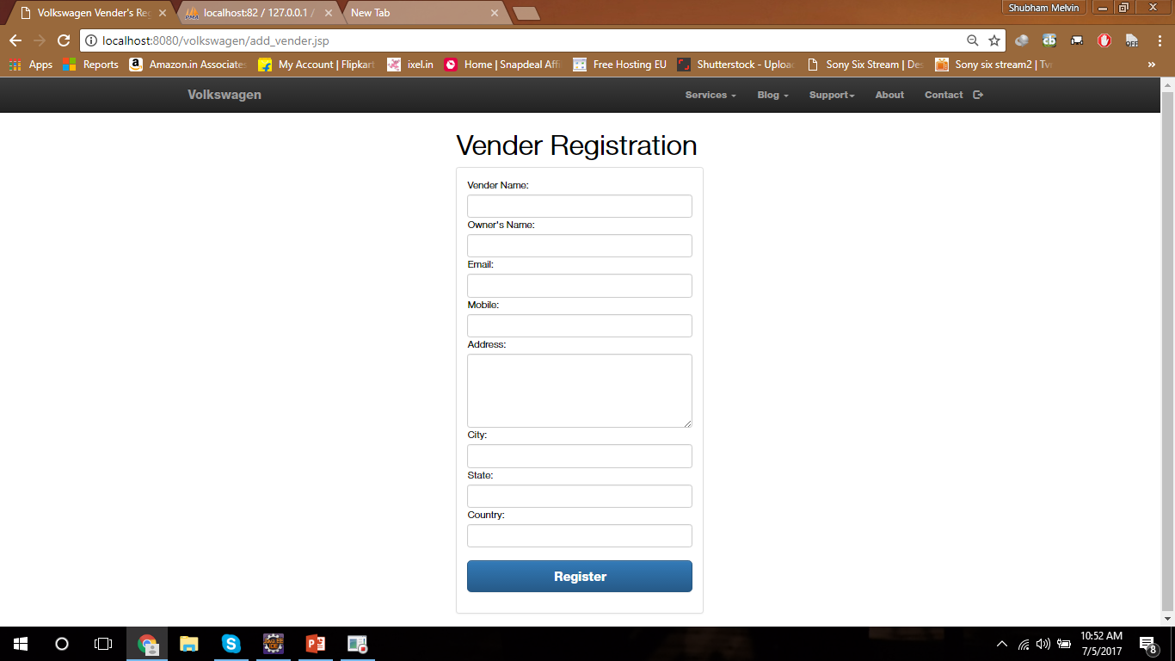
Vender’s registration

Slide 12
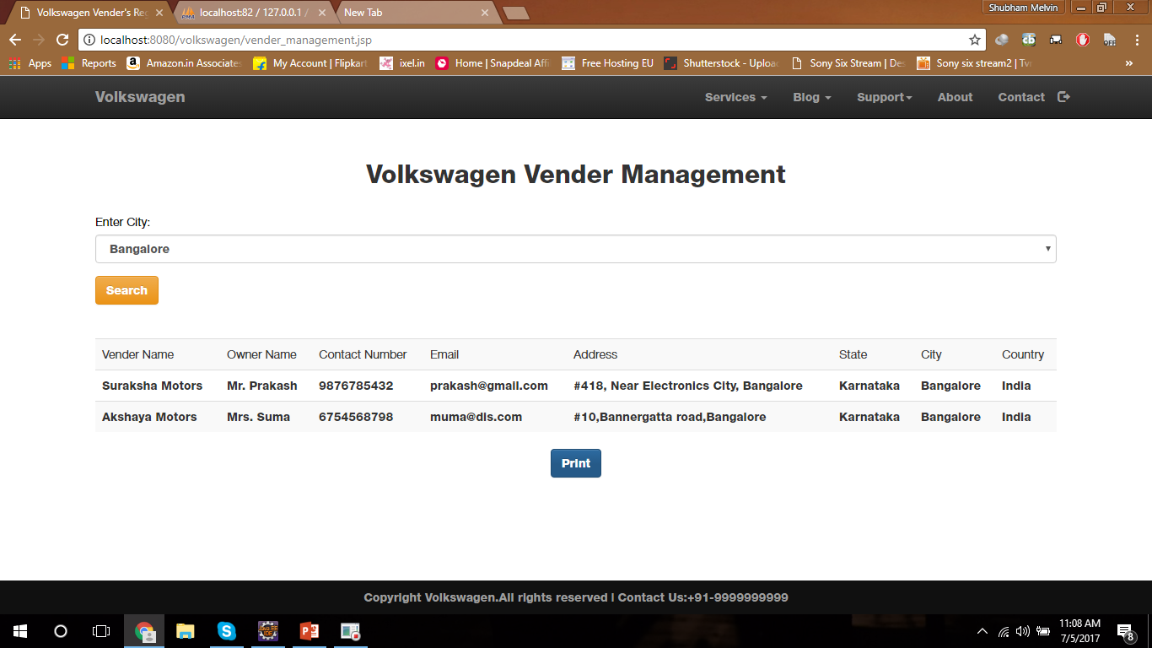
Vender’s management

Slide 13
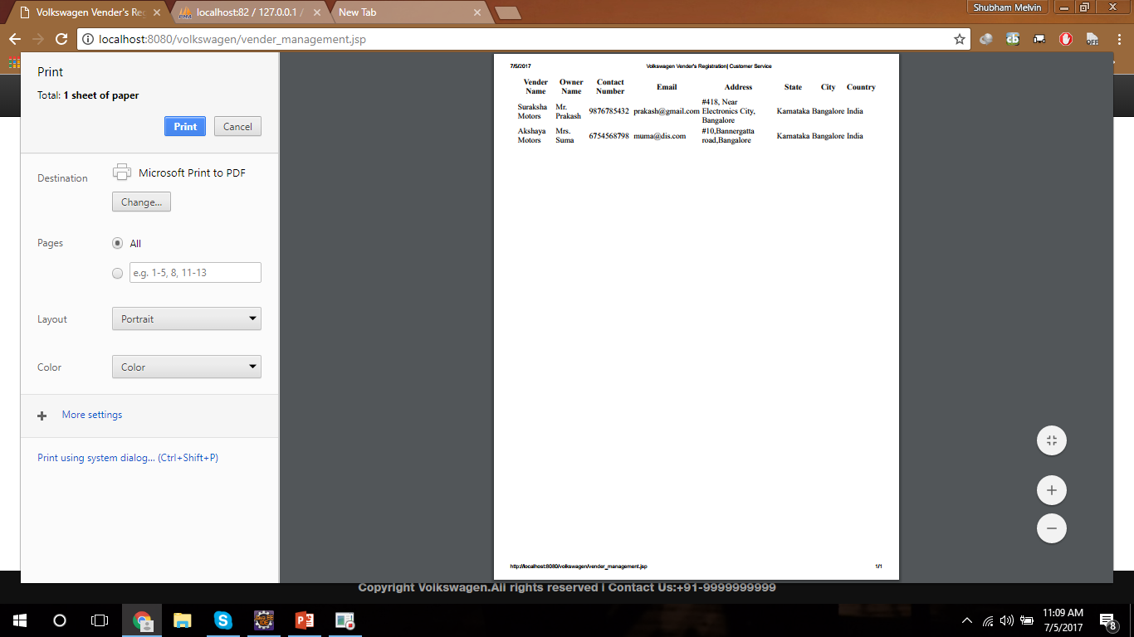
Vender’s list print preview

Slide 14

Database structures

Slide 15
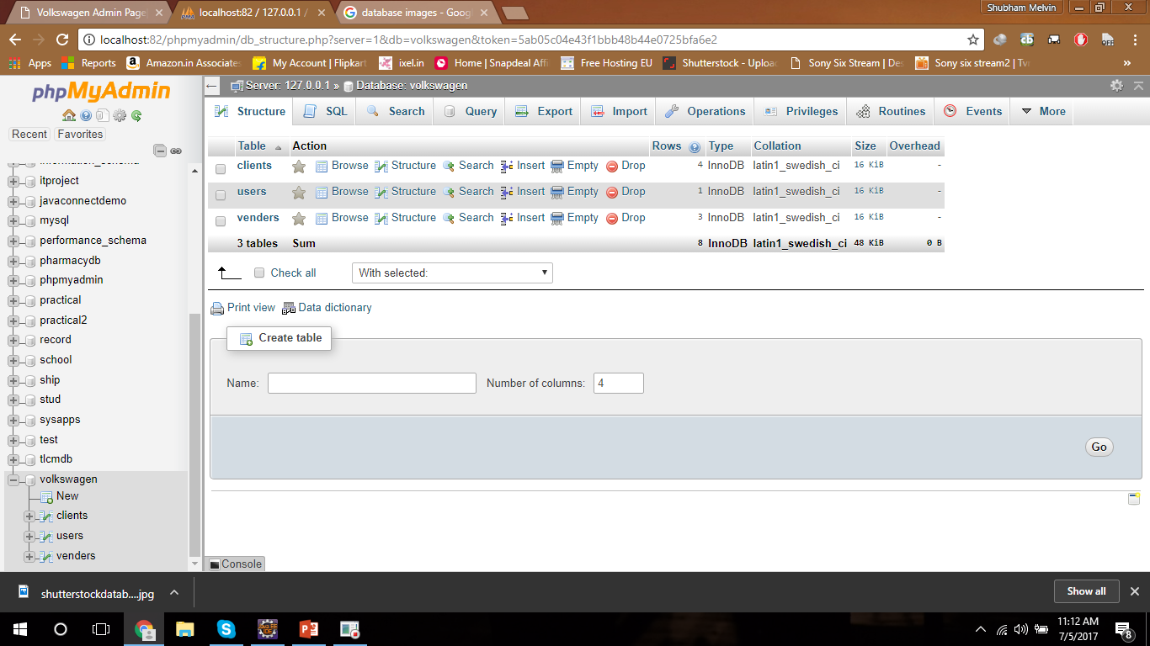
List of tables
Users Table
Clients Table
Venders Table

Slide 16
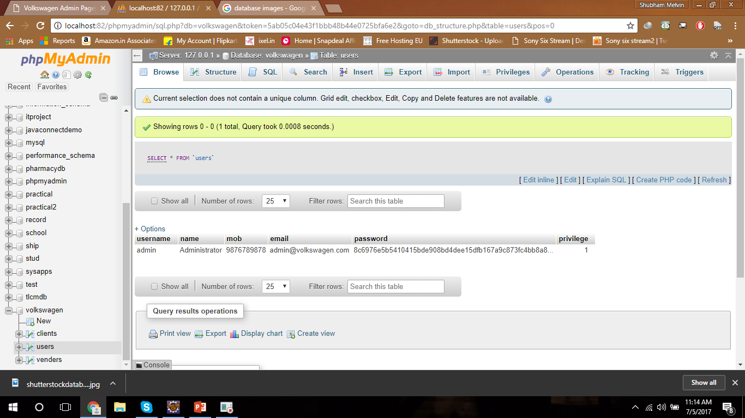
Users table
Columns
Username : VARCHAR
Name : VARCHAR
Mobile : VARCHAR
Email id : VARCHAR
Password : VARCHAR
Privilege : INT

Slide 17
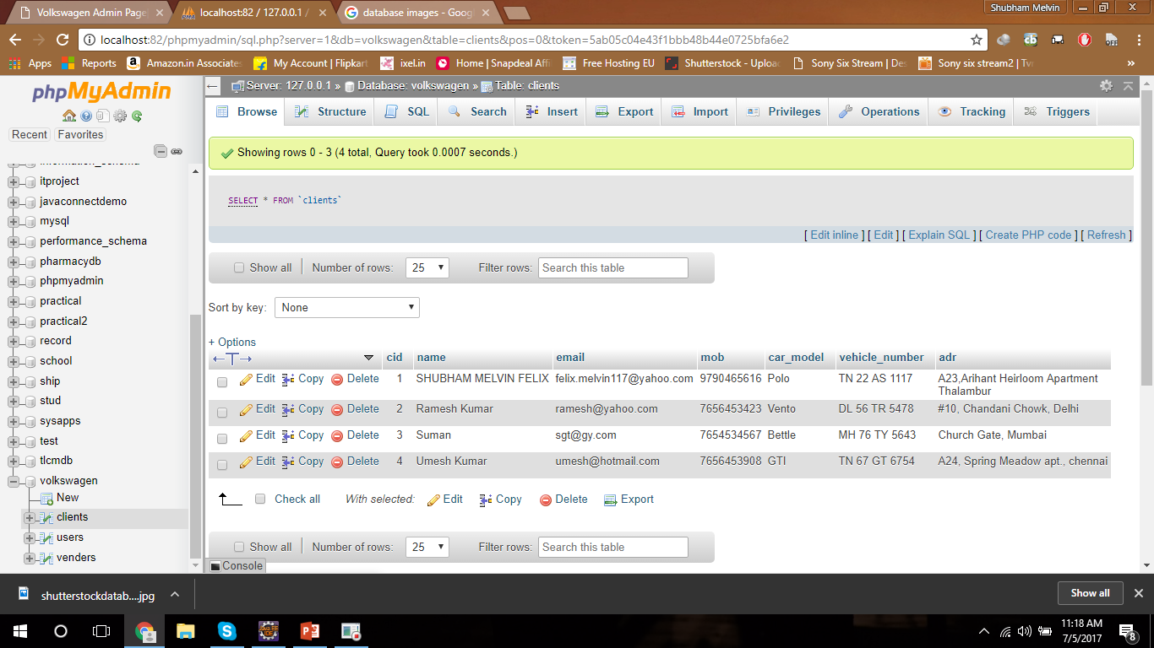
Clients table
Columns
Cid : INT AI Primary
Name : VARCHAR
Mobile : VARCHAR
Email id : VARCHAR
Car Model : VARCHAR
Vehicle Number : VARCHAR
Address : VARCHAR

Slide 18
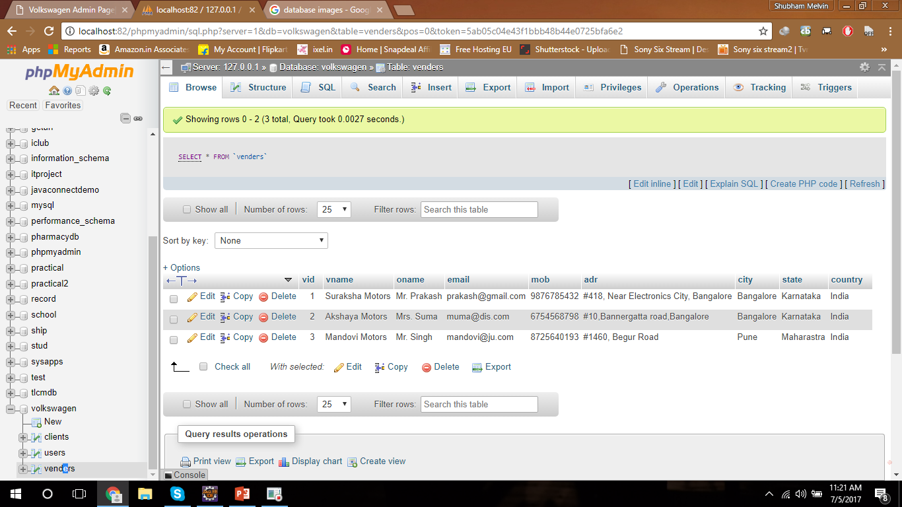
Venders table
Columns
Vid : INT AI Primary
V Name : VARCHAR
O Name : VARCHAR
Mobile : VARCHAR
Email id : VARCHAR
Address : VARCHAR
CITY : VARCHAR
STATE : VARCHAR
COUNTRY : VARCHAR

Slide 19
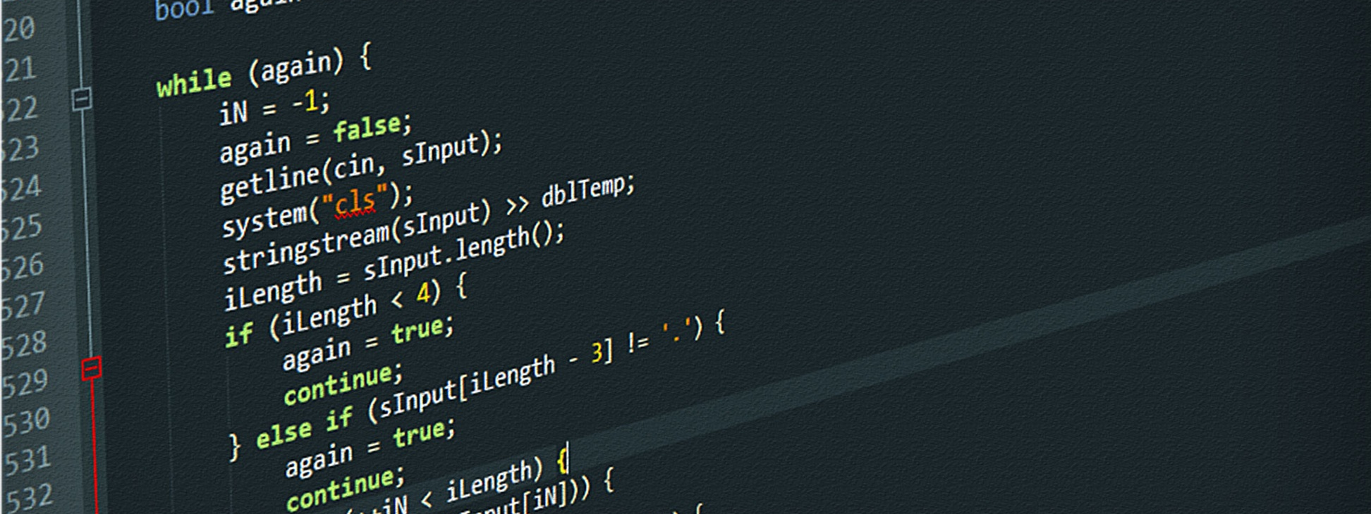
ITSSB (IT Software Solution for business skill)

Slide 20
SEO
Organic Optimization

Slide 21
Thank You! ☺

